Slide 1

Blinkit sales Dataset
PowerBI Dashboard

Slide 2
About Blinkit
A fast-growing instant delivery platform.
Purpose of Analysis: Enhance operational efficiency, customer experience, and business performance.
Key Focus Areas: Sales, customer feedback, delivery performance, inventory management, and marketing.

Slide 3
Problem Statement
Challenges Identified:
Delays in delivery impacting customer satisfaction.
Need to analyze sales performance & customer trends.
Improving marketing ROI.
Inventory management inefficiencies.
Goal: Data-driven decision-making for optimized operations and increased revenue.

Slide 4
Data Preprocessing & Methodology
Initial Data Processing Steps:
Identified and handled missing values and null values.
Cleaned and standardized dataset fields.
Ensured consistency in date and categorical values.
Datasets Used:
Customer feedback & segmentation.
Sales and order details.
Delivery performance metrics.
Product inventory data.
Marketing campaign performance.
Tools Used: Power BI for data visualization and analysis.

Slide 5
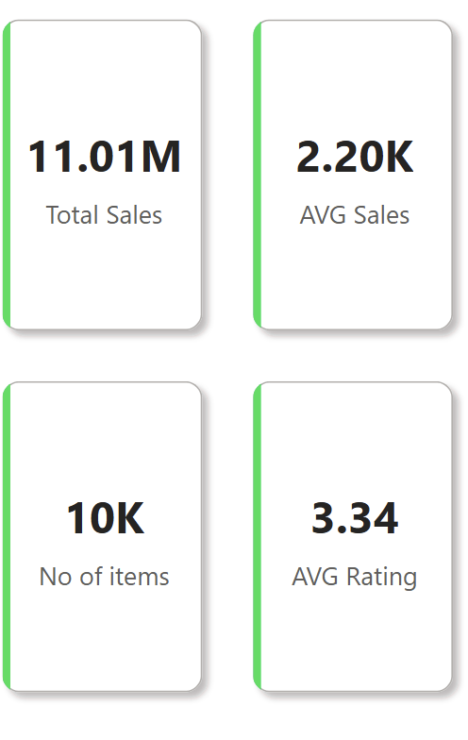
Key Performance Metrics (KPIs)
Total Sales: 11.01M
Average Sales per Order: 2.20K.
Number of Items Sold: 10K
Average Customer Rating: 3.34
Delivery Performance: Breakdown by on-time vs. delayed deliveries.

Slide 6
Sales Analysis
Sales Analysis
Sales Trends by Time Period:
Quarterly and monthly sales performance.
Category-wise Sales Breakdown: Top-performing product categories.
Sales vs. Customer Sentiment: Positive feedback correlation.

Slide 7
Customer Feedback & Sentiment Analysis
Sentiment Breakdown: Positive, Neutral, Negative.
Impact on Sales: Higher ratings linked to increased purchases.
Common Issues from Feedback: Delivery delays, product quality concerns.

Slide 8
Delivery Performance Insights
On-Time vs. Delayed Deliveries:
% of significantly delayed vs. slightly delayed orders.
Geographical Insights: Regions with high delay rates.
Action Plan: Optimizing logistics to reduce delays.

Slide 9
Conclusion
Impact of Data-Driven Decisions: How insights can transform Blinkit’s operations.
Final Thoughts: Leveraging Power BI for continuous monitoring & improvement.
Thank You!

